Slide 1

PYTHON CASTING

Slide 2
Specify a Variable Type
There may be times when you want to specify a type on to a variable. This can be done with casting. Python is an object-orientated language, and as such it uses classes to define data types, including its primitive types.
Casting in python is therefore done using constructor functions :
int() - constructs an integer number from an integer literal, a float literal (by removing all decimals), or a string literal (providing the string represents a whole number)
float() - constructs a float number from an integer literal, a float literal or a string literal (providing the string represents a float or an integer)
str() - constructs a string from a wide variety of data types, including strings, integer literals and float literals
Python - Casting

Slide 3
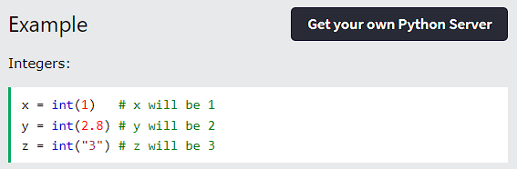
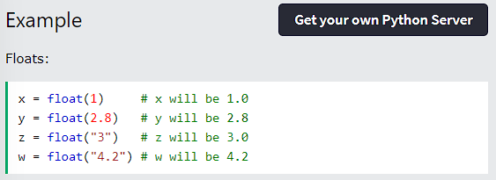
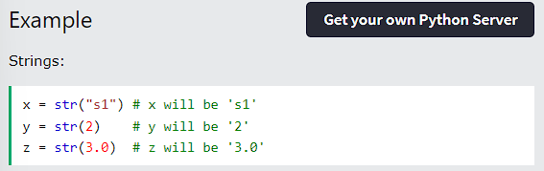
Specify a Variable Type
Python - Casting

Slide 4
THANK YOU

